Slide 1
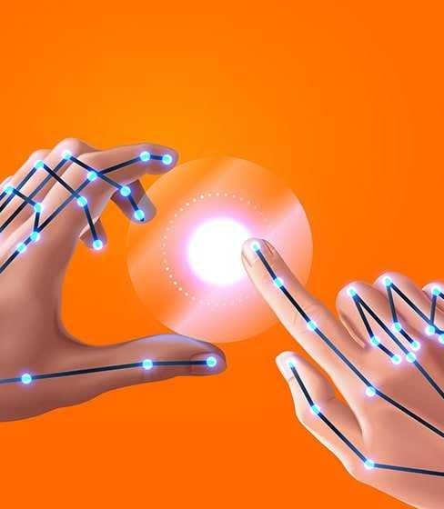
Virtual Mouse Controlled by Eye and Hand Gestures
Presented by: Group-12
Munna Biswas (221-15-5261)
Mehenaz Afsana (221-15-5693)
Afrin Jahan Moon (221-15-5499)
1

Slide 2

Objective
To develop a virtual mouse that uses eye and hand gestures for operation.
Enhance accessibility to supports users with physical disabilities
Ensure the system operates smoothly and accurately in real-time.
Contributing to the field of gesture-based computing.

Slide 3


Tobii Eye Tracker: A high-precision eye tracking solution used in gaming and assistive technology. Leap Motion: A hand gesture control device commonly used for VR and other interactive applications. EyeX: Another eye tracking system used for accessibility and gaming.
Existing Solutions in Market/Web
3

Slide 4
Users and Stakeholders
Users:
People with physical disabilities.
Gamers looking for an innovative control method.
General users seeking hands-free control.
Stakeholders:
Developers.
Investors.
Accessibility advocates.

Slide 5





Name of Features
Eye & hand gaze tracking for cursor movement.
Customizable sensitivity
gesture recognition for clicks and other actions.

Slide 6
Implementation Requirements
Hardware:
Webcam or eye tracker.
Software:
Python
Libraries for eye and hand tracking (OpenCV, MediaPipe, PyAutoGUI)

Slide 7
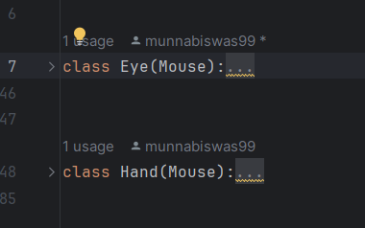
Application of OOP in the Project
Encapsulation
Wrapping the tracking and recognition functionalities within classes.

Slide 8
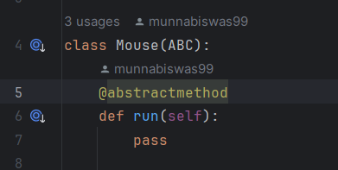
Application of OOP in the Project
Inheritance
Creating base classes for common functionalities and deriving specialized classes for eye and hand tracking.

Slide 9
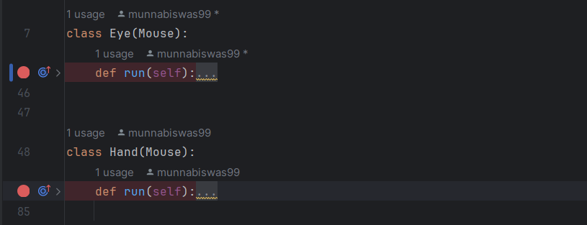
Application of OOP in the Project
Polymorphism
Implementing method overriding for different types of gestures.

Slide 10
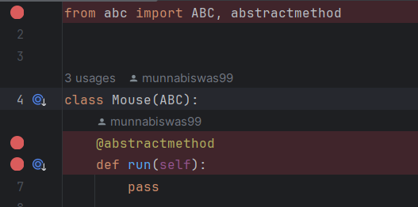
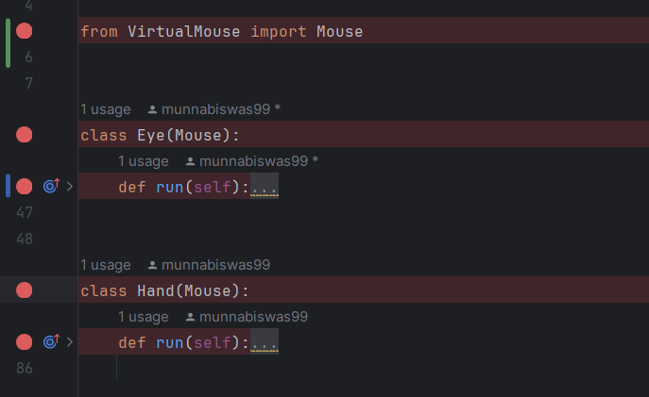
Application of OOP in the Project
Abstraction
Providing a simplified interface for gesture control without exposing the complex implementation details.

Slide 11
Challenges and Solutions
Challenge: Accurate eye and hand tracking.
Solution: Implemented advanced algorithms and continuous calibration.
Challenge: Real-time performance.
Solution: Optimized code and utilized efficient libraries.
Challenge: User adaptability.
Solution: Provided customizable settings and thorough user testing.

Slide 12


Innovative Feature
Dual Control:
Simultaneous use of eye and hand gestures for enhanced precision and control.
Adaptive Learning:
System learns and adapts to user’s behavior over time to improve accuracy.

Slide 13


Observations
User Feedback:
Users find the system intuitive and useful, especially those with physical impairments.
Performance:
Real-time tracking works efficiently on standard hardware.
Usability:
Initial calibration is crucial for accurate performance.

Slide 14




Thank you
14

